Slide 1


Data Science with Python
Translational Data Analytics Institute
An introduction to scikit-learn

Slide 2
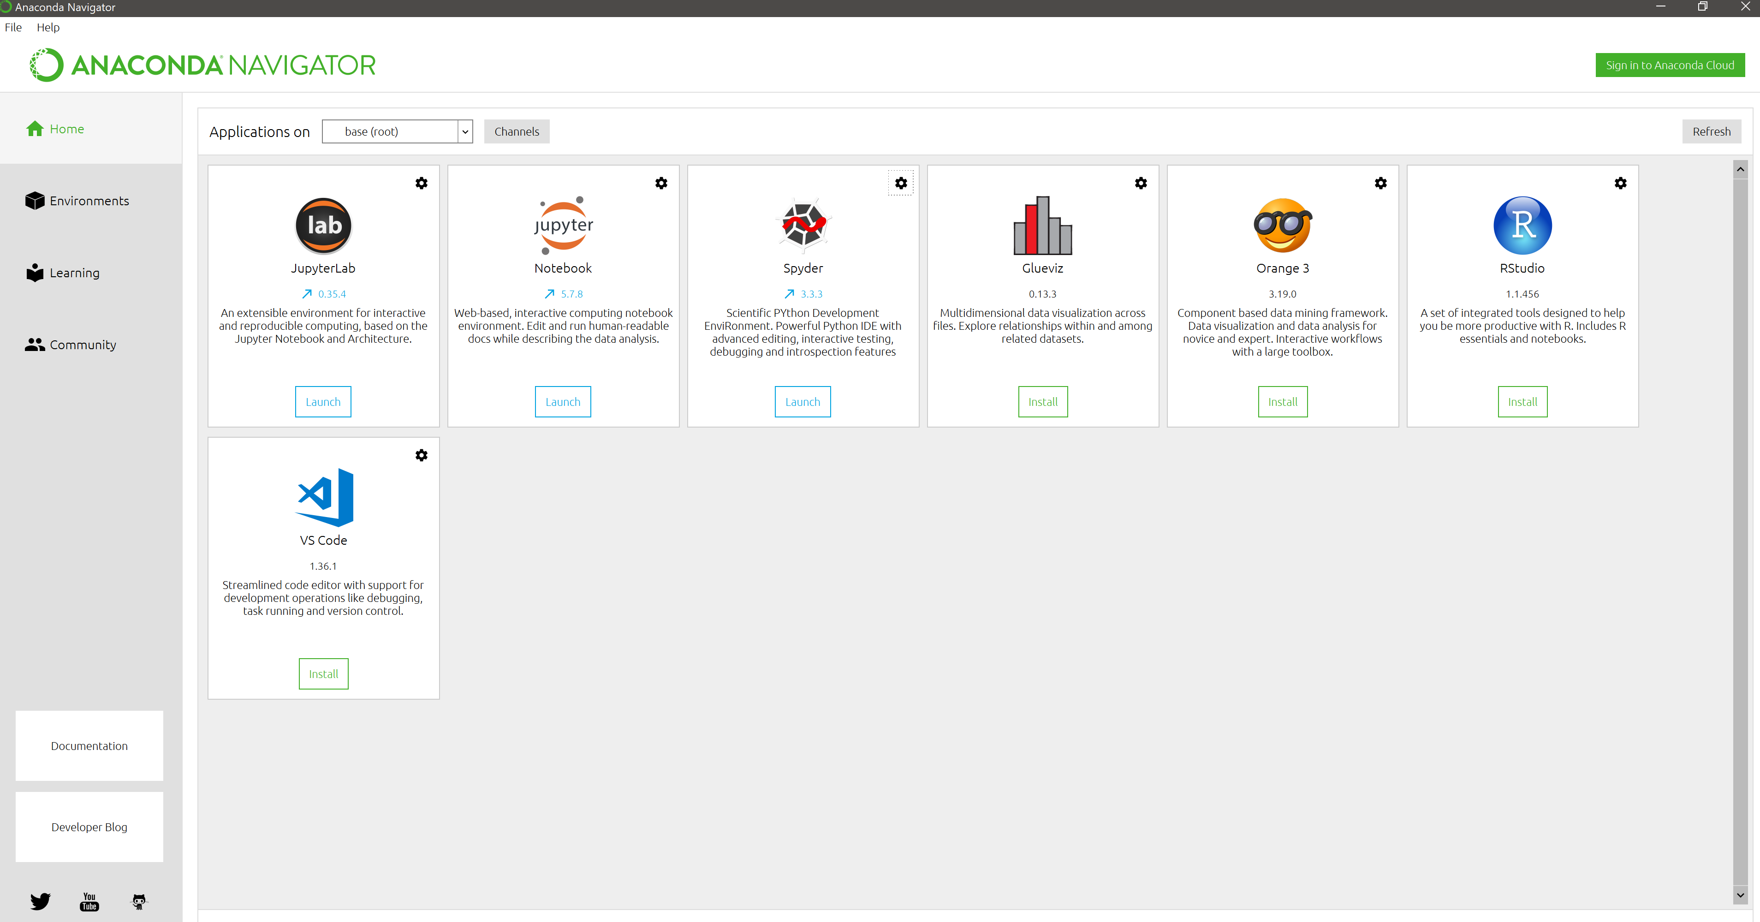
Requirements for this Presentation
Python 3.5 or higher
Scikit-learn
Pandas
NumPy
Matplotlib
Anaconda
Open- source data science and machine learning distribution that contains over 1,500 Python and R packages, including all packages used in this presentatin
https://www.anaconda.com/distribution/
Code and datasets used in this presentation:
https://github.com/justin-ditty/sci-kit-learn-Presentation
Download Anaconda, code and datasets so you can follow along with the presentation

Slide 3
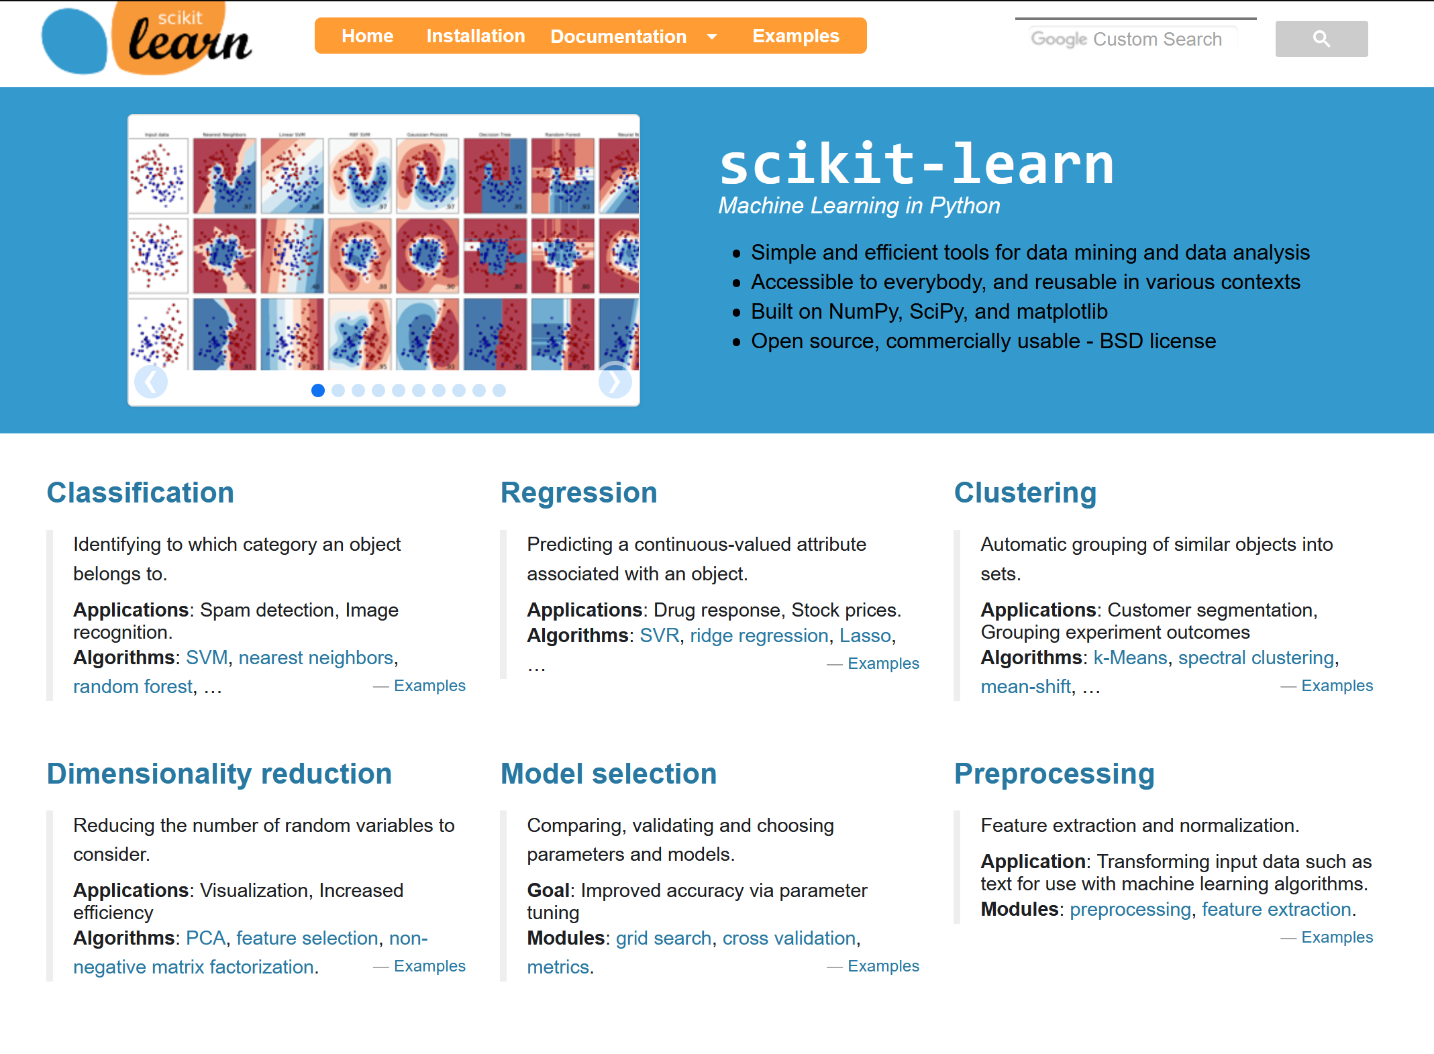
Scikit-learn Package
Largest, Most Comprehensive Machine Learning Python Package
Contains modules for:
Preprocessing
Regression
Classification
Clustering
Dimensionality Reduction
Model Selection and Evaluation Metrics
Contains modules for building, training, and evaluating common supervised and unsupervised machine learning methods.

Slide 4
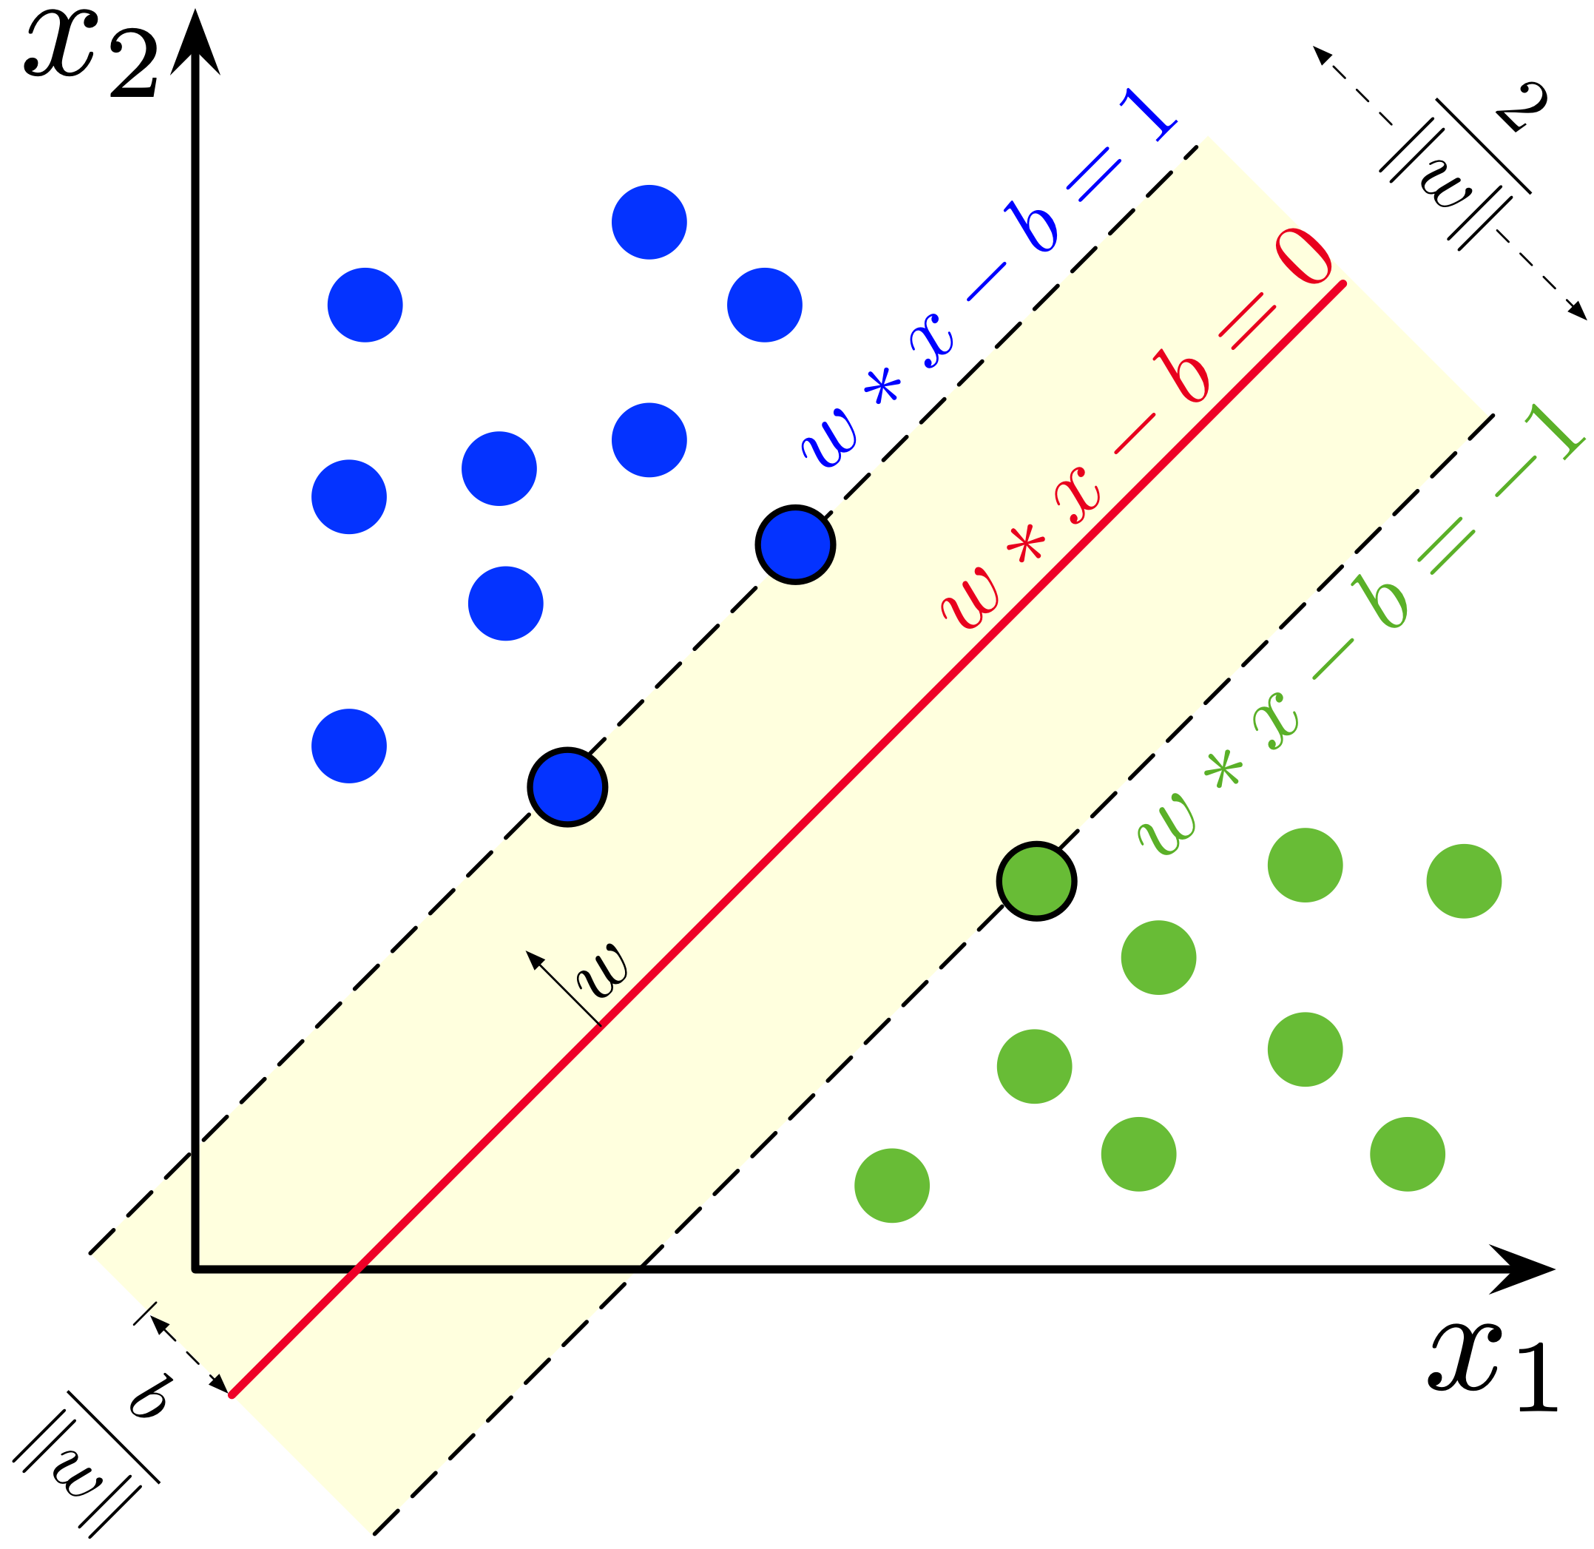

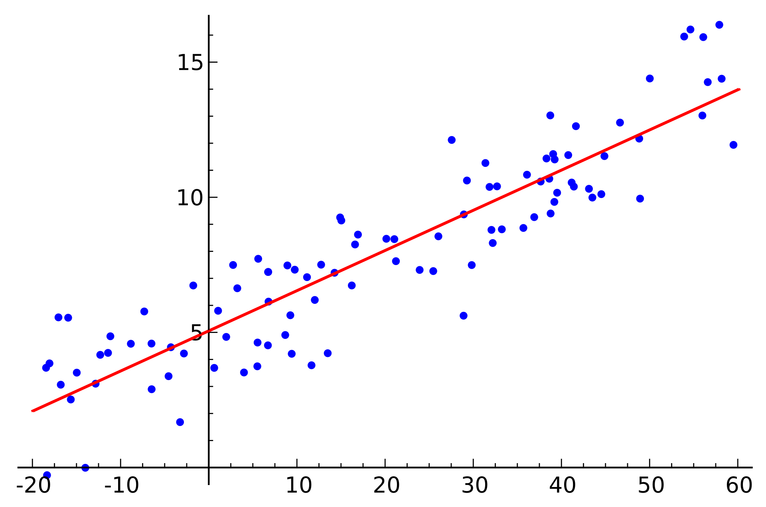
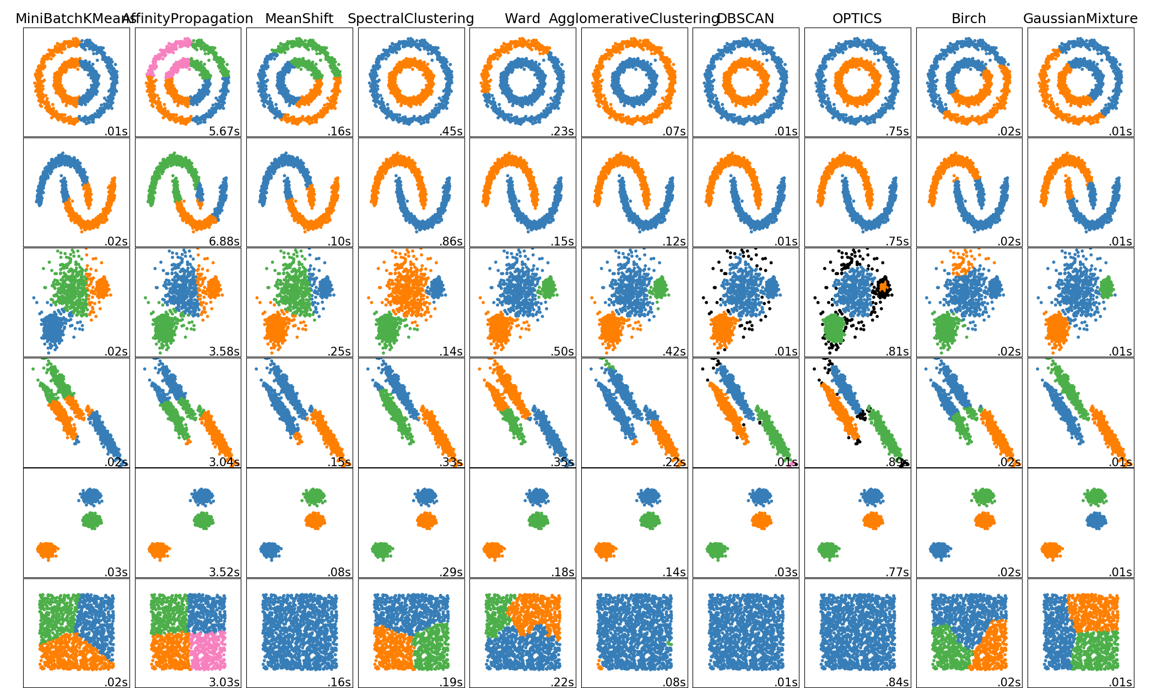

sklearn Overview
Regression
Classification
Clustering
Dimensionality Reduction
Model Selection
OLS
Ridge
Lasso
Bayesian
Logistic
Naïve Bayes
Decision Trees
Support Vector Machines
k-Means Clustering
Spectral Clustering
Mean Shift
Principal Component Analysis
Feature Selection
Cross Validation
Metrics

Slide 5
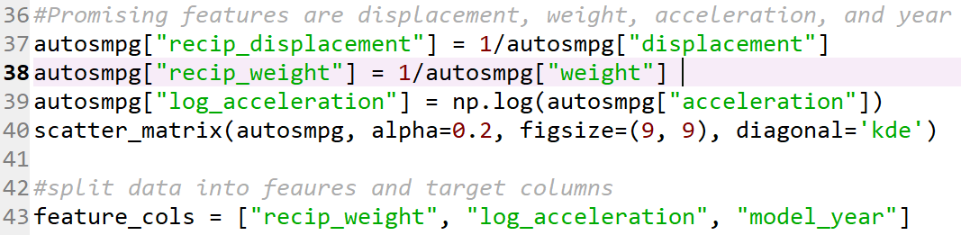
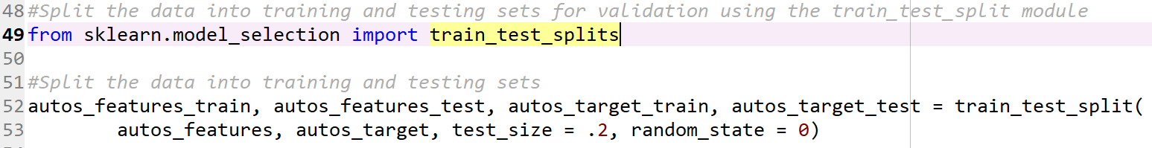
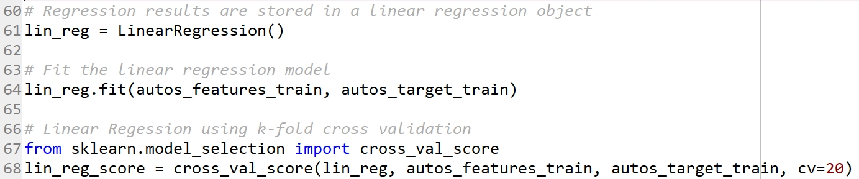
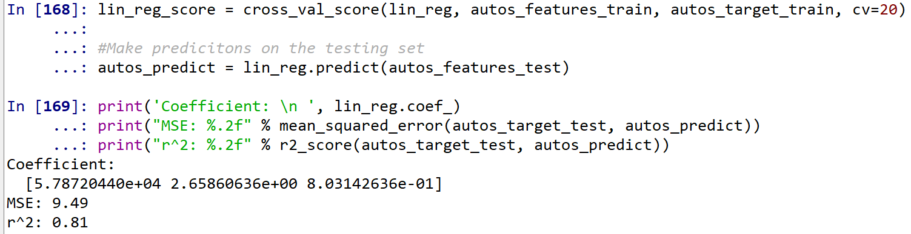
Scikit-Learn Model Training Process
Preprocess Data and Select Features
Split Data into Training and Testing Sets
Fit the Model on the Training Set
Evaluate the Model’s Performance on Test Set
Statistical modeling using Scikit-learn is separated into 5 distinct steps
Refine Model and Tune Hyper Parameters

Slide 6
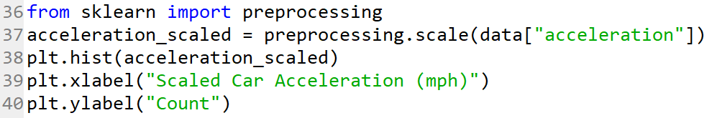
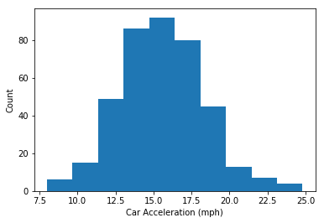
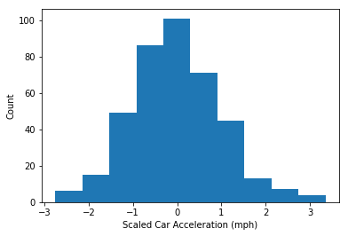
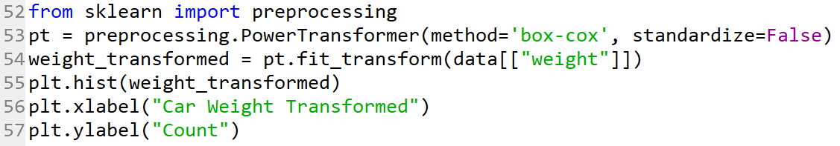
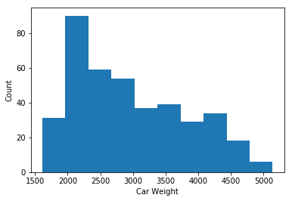
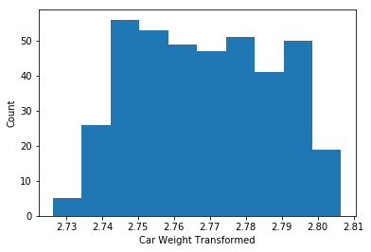
Data Preprocessing and Feature Extraction
Preprocessing.scale()
Scales data to the standard normal distribution
Preprocessing.PowerTransformer()
Maps nonnormally distributed data to as close to a normal distribution as possible
Sci-kit learn contains modules that help scale, transform and extract features from datasets

Slide 7
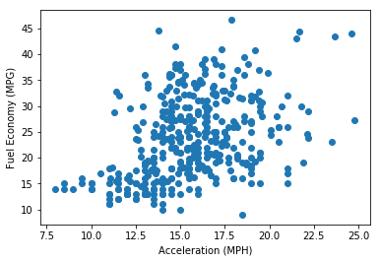
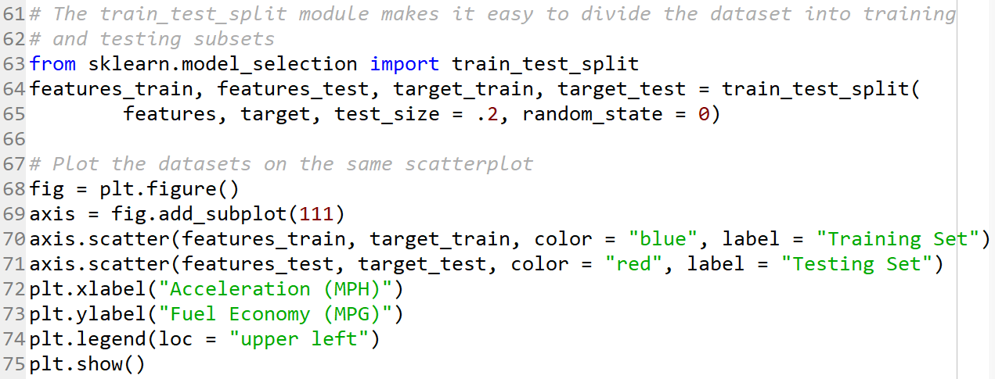
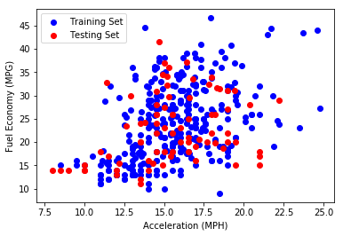
Splitting Data into Training and Testing Sets
model_selection.train_test_split()
Divides your feature and target variables into disparate training and testing subsets
Sci-kit learn makes it incredible easy to create training and testing sets out of your selected features

Slide 8
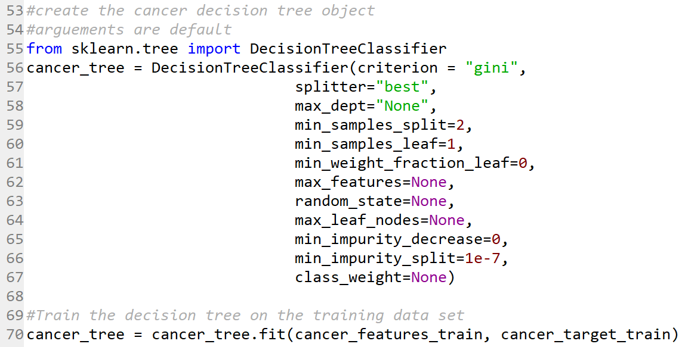
Fitting Models and Training Classifiers
Scikit-learn Regression and Classifier objects
All use the .fit() function to fit statistical models to the data
Using the fitting function

Slide 9
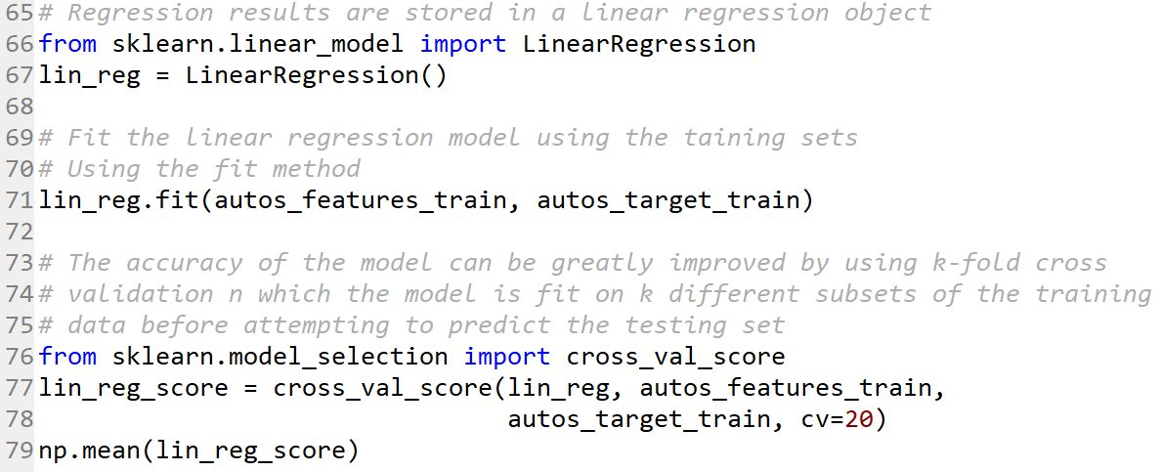
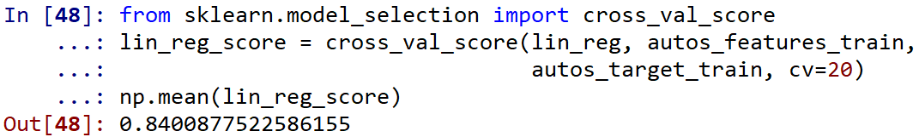
Model Evaluation
Model_selection.cross_val_score()
Splits your training set into k subsets of training and testing sets and evaluates your model's accuracy on each of the k testing sets.
You can then calculate your model’s score at each slice of the dataset before attempting to predict the testing data.
K-fold cross validation

Slide 10
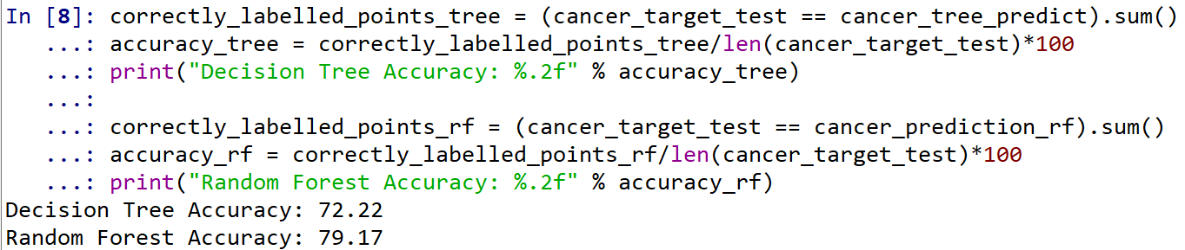
Model Evaluation
MLObject.predict(features_testing_set)
Uses feature values of your testing set to predict the testing set’s target values.
You can then calculate the model’s accuracy by comparing the predicted values vs the actual values.
K-fold cross validation

Slide 11
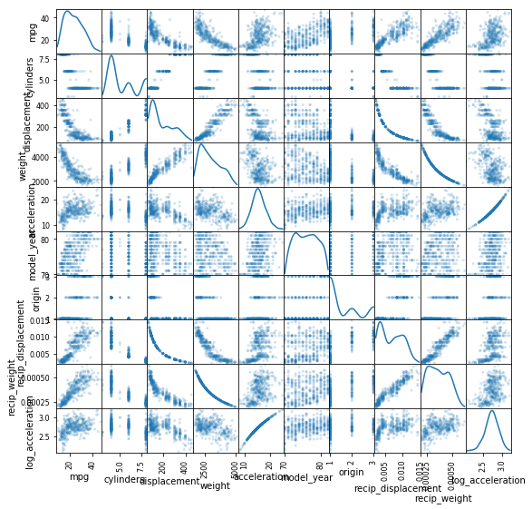
Linear Regression Example
Data Preprocessing and Feature Extraction
Splitting Data into Training and Testing Sets
Model Training
Evaluate the Model’s Performance on Test Set
https://archive.ics.uci.edu/ml/datasets/Auto+MPG

Slide 12
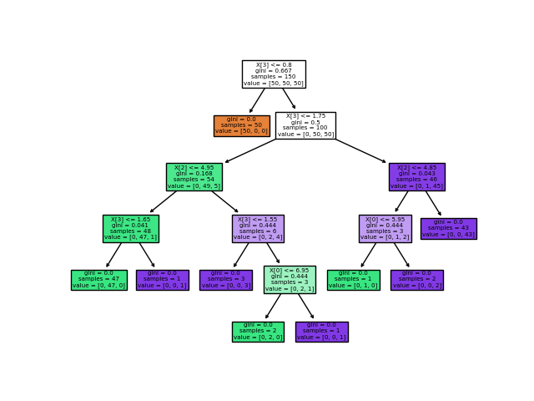
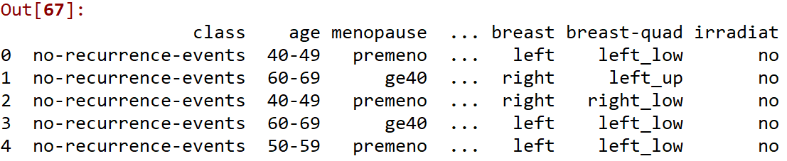
Classification Example
Breast Cancer Dataset
1 Target:
Class: Recurrence Events
9 Potential Features
Age Range: 30-39, 40-49, 50-59, 60-69, 70-79
Pre or Post Menopause
Tumor Size: Range 0-4, 5-9, … , 55-59
Inv-Nodes 0-2, 3-5, … , 36-39
Node Caps: Yes or no
Deg-Malignant: 1, 2, 3
Left or Right Breast
Breast Quadrant: upper left, upper right, lower right, lower left, central
Irradiated: Yes or No
All are categorical: Random Forest of Classification Trees
https://archive.ics.uci.edu/ml/datasets/Breast+Cancer

Slide 13
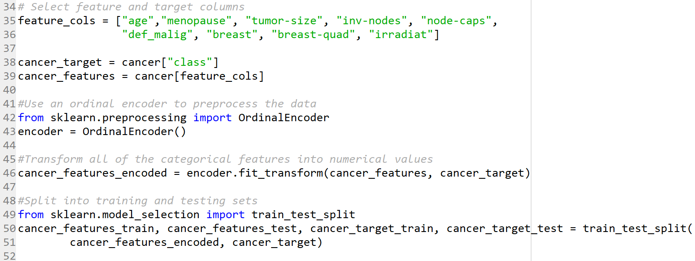
Classification Example
Split Into Feature and Training Set and Preprocess Data
Decision trees in sklearn require that all data in the feature columns be numerical.
Fortunately sklearn the OrdinalEncoder module will replace ordered categorical predictors with numerical substitutes.
https://archive.ics.uci.edu/ml/datasets/Breast+Cancer

Slide 14
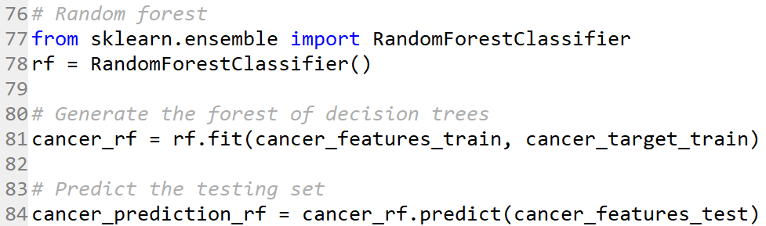
Classification Example
Train the Decision Tree on the Training Set
Evaluate the Model’s Performance
https://archive.ics.uci.edu/ml/datasets/Breast+Cancer

Slide 15





Thank You
Translational Data Analytics Institute
Justin Ditty
+1 513-376-3459
ditty.15@osu.edu

Slide 16
Sources
Anaconda: https://www.anaconda.com/distribution/
Scikit-learn Documentation: https://scikit-learn.org/stable/user_guide.html
Autos MPG Data Set: https://archive.ics.uci.edu/ml/datasets/Auto+MPG
Breast Cancer Data Set: https://archive.ics.uci.edu/ml/datasets/Breast+Cancer
Regression Image: https://en.wikipedia.org/wiki/Regression_analysis#/media/File:Linear_regression.svg
Classification Image: https://en.wikipedia.org/wiki/Support-vector_machine#/media/File:SVM_margin.png
Clustering Image: https://scikit-learn.org/stable/auto_examples/cluster/plot_cluster_comparison.html
Cross Validation Image: https://scikit-learn.org/stable/modules/cross_validation.html
Decision Tree Image: https://scikit-learn.org/stable/modules/tree.html

